Slide 1
Jarne Hofmann
Diego Aguilar
Ahmet Korkmaz
An API for outgoing correspondence sent by Thomas Mann

Slide 2
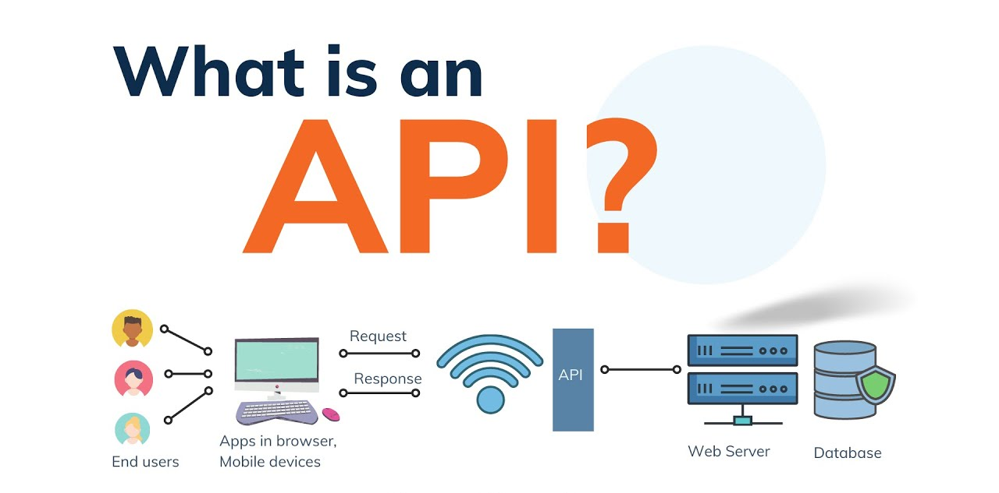
Source: Diagram created by Ayushi Rawat

Slide 3
